Slide 1


Engaging Students with Biostatistics by Conducting Clinical Trials on The Island
Joint Statistical Meetings, Boston
August 5, 2014
Ann M. Brearley and Susan E. Telke
Division of Biostatistics
University of Minnesota

Slide 2
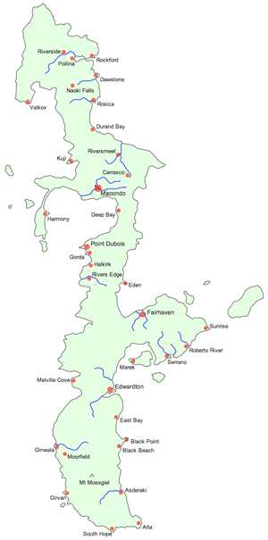
GAISE College Guidelines
1. Develop statistical thinking
“We should teach students that the practical operation of statistics is to collect and analyze data to answer questions.”
2. Use real data
4. Foster active learning
5. Use technology (for developing concepts and analyzing data)…
Notes:
1, 2 and 4 often approached using individual or group projects. Projects relevant to medical and public health professionals are difficult to come by.
5 technology (Island) allows students to design and carry out a real-seeming clinical trial of their own without running afoul of IRB’s.

Slide 3

Outline
Goal
Theme
Introductory biostatistical methods
Variations
Clinical trials
Summer Institute in Biostatistics (SIBS)
Statistical consulting
Biostatistical literacy
Notes:
Goal: to make you think that this is the coolest teaching tool ever and you can’t wait to try it!

Slide 4
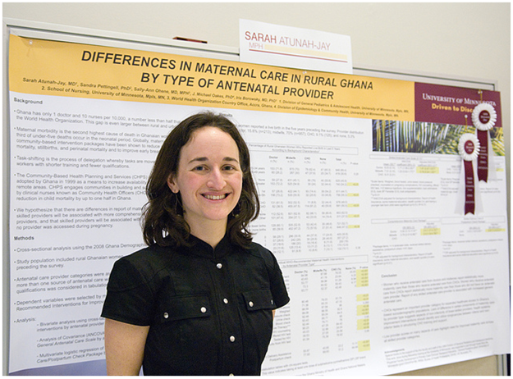
Theme Introductory Biostatistical Methods
PubH 6414
Taught in fall, spring and summer terms
Offered both in-person and online
R Commander software
Class size ~ 50 – 75 students, 3 TAs
Varied backgrounds: physicians, dentists, nurses, veterinarians, pharmacists, public health graduate students and professionals, a few journalists, lawyers
Notes:
Photo from UofM global pediatrics blog, posted April 25, 2011. MPH student project.

Slide 5
Basic Island Project Fall 2012+
Students work in groups to design, conduct, and analyze results of a study using the Island
Groups of ~5 to 8 students
TAs serve as statistical consultants
Students present their findings to the class at the end of the course
Talks (live or recorded)
Posters
Research papers
CONSORT guidelines for reporting randomized controlled clinical trials are used
Part of the grade is based on peer evaluations and on instructor-judged participation
Notes:
First used Fall 2012, online and in-person, by Susan and Ann. Later adopted by Rob and Laura. All for 6414.

Slide 6
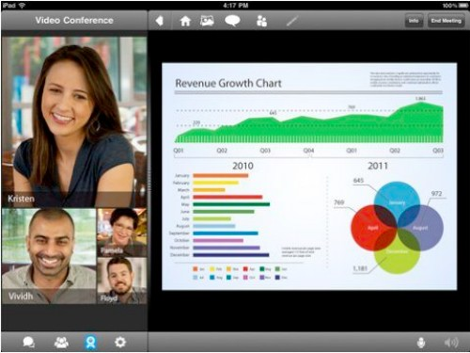


Collaborating Online
Groups collaborate using various tools:
Google Hangouts, Skype, FaceTime, etc.
Google Drive, DropBox
Moodle chat rooms
phone, text, email
Works best if groups meet weekly
as the in-person students do (in lab)
Notes:
Images (top to bottom) from FaceTime, Google Hangouts, and Skype websites.

Slide 7


PubH 6414 Island Studies Fall 2013 Online Class
Effects of Methamphetamine on Cognitive Function in Young Adults
RE-WINE: The Effect of Red Wine on Serotonin Release
The Effect of Cannabis Tea on Short Term Memory Scores
Effect of diabetes on the blood glucose level of “The Island” population after exercise
YIKES! Youth Islander Knowledge Enhancement Study [Effect of Dextroamphetamine on Arithmetic Performance]
Effects of Smoking on Pulmonary Functioning and Exercise Tolerance
Effects of Music on Blood Pressure
The DREAM Study: The Effect of Different Exercise Assignments on Melatonin
Notes:
Images are from Fall 2013 Online student projects
Mention benefits briefly here; more detail later.

Slide 8

First Variation Clinical Trials Course
Taught fall and summer
Online only
Class size ~ 20 students, 1 TA
Dual audience: undergraduates (public health minors) and graduate students (physicians, dentists, nurses, veterinarians, pharmacists, public health graduate students and professionals, a few journalists, lawyers)
Notes:
First used Fall 2013 by Susan and Haitao.
Image from MNepilepsy.org

Slide 9
Clinical Trials Projects Fall 2013+
Undergrads: Island project
Reviewed by a mock DSMB composed of the graduate students
Few adverse events
Limited ability to follow participants for long periods of time
Grad students: Protocol project
Students write a complete study protocol
Reviewed by a mock IRB made up of the undergraduate students
Notes:
Grad students may have used Island before when they took PubH 6414 (prereq).

Slide 10
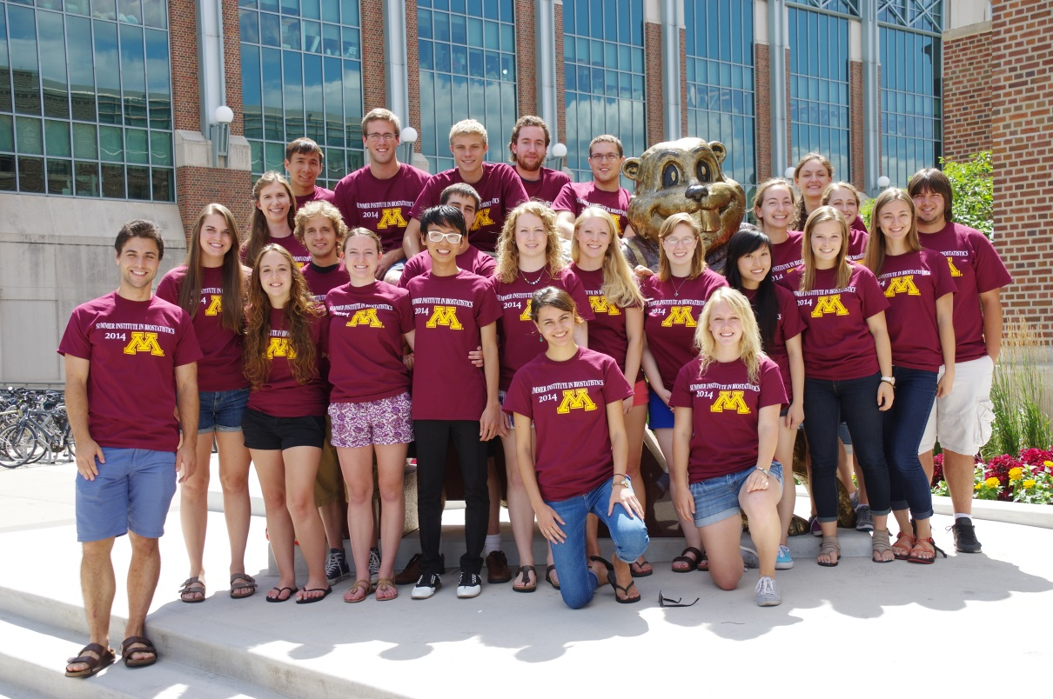
Second Variation Summer Institute in Biostatistics
Six-week full-time in-person summer program
SAS or R software
Class size = 25 students, 2 TAs, 2 instructors
Undergraduates, mostly juniors, potentially interested in careers in biostatistics
Notes:
First used summer 2013 by Susan and Greg

Slide 11
SIBS Island Projects Summer 2013+
Completed in much shorter time period, about three weeks.
More complex, ambitious projects:
Observational studies, genomic studies, spatial statistics studies, epidemiologic studies, repeated measures, cross-over designs, factorial designs

Slide 12
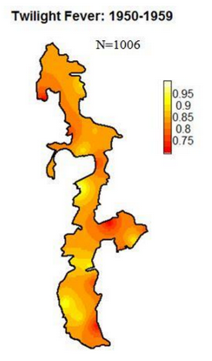
SIBS Island Projects Summer 2014 Class
Genetic Analysis of Summer's Pain (GASP)
Comprehensive Analysis of Twilight Fever in Island Towns (CATFIT)
Can Altering Student’s Testing Actions Work Across Youth (CASTAWAY)
Analysis of the Short Term Effects of Caffeine on Hunger (ASTECH)
Physical Ability from Coffee and Energy Drinks (PACED)
Study and Analysis of Depression on Classical-Music Efficacy and Needle-Injected Serotonin (SAD OCEANS)
Notes:
The projects are from Summer 2014.
Genetic Analysis of Summer's Pain (GASP) -- genetics
Comprehensive Analysis of Twilight Fever in Island Towns (CATFIT) –spatial (map: proportion of all deaths due to Twilight Fever, by village)
Can Altering Student’s Testing Actions Work Across Youth (CASTAWAY) –repeated measures, mixed models
Analysis of the Short Term Effects of Caffeine on Hunger (ASTECH) -- crossover
Physical Ability from Coffee and Energy Drinks (PACED) – cross-over
Study and Analysis of Depression on Classical-Music Efficacy and Needle-Injected Serotonin (SAD OCEANS) – two-way factorial

Slide 13
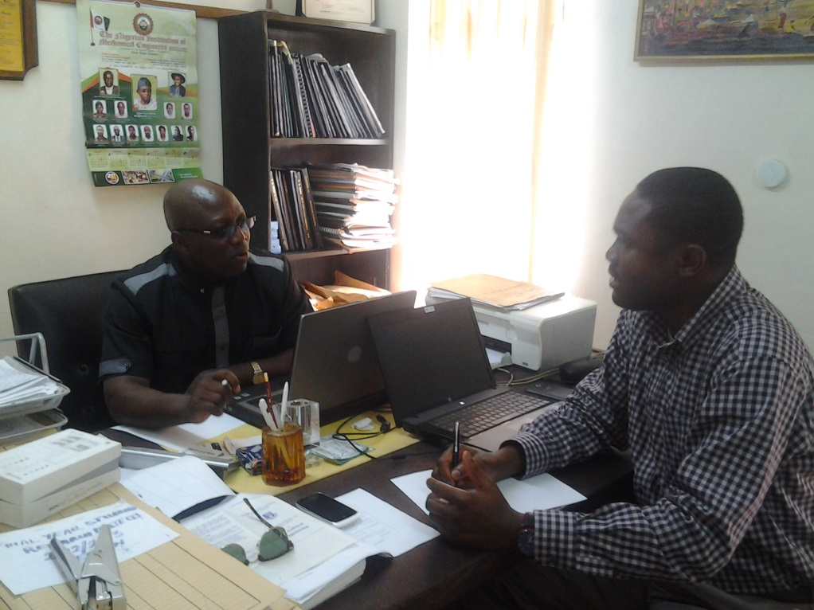
Third Variation Statistical Consulting Course
Collaboration between the Department of Statistics and the Division of Biostatistics
Statistics 4893W (in-person):
Consulting / senior project / writing course
Senior undergraduate statistics majors
PubH 6414 (online):
Graduate students: medical and public health professionals
Notes:
First used Spring 2014 by Marta (stats) and Laura (biostats). Evaluator = Ann.
Class of 75 in PubH 6414 with three Tas. Each TA had to consult with three or four groups – too hard.
Image from LISA 2020 website blog – consulting in Nigeria.

Slide 14
Statistical Collaboration on the Island Spring 2014+
Teams of three senior statistics majors in Stat 4893W serve as statistical consultants for client teams of public health graduate students in PubH 6414 (one team to one team)
Meet with clients via Google Hangouts or Skype
Help design study
Analyze pilot study data
Estimate main study sample size
The statistics students’ consulting report serves as one of their class assignments.

Slide 15
Formal Evaluation
To assess and improve the collaboration
Surveyed both ‘clients’ and ‘consultants’
Used Qualtrics online survey tool
‘Consultant’ comments:
“I had an interview at the Federal Reserve Board where I discussed my consulting experience. They seemed very impressed that I got such an experience.”
“I recently had an interview and they were interested in [my] interactions with the biostats students, the results that my group came up with and the Island program itself.”

Slide 16

Fourth Variation Biostatistical Literacy Course
New course in Fall 2014
Focus is on understanding the medical/public health literature: t-tests through survival. No calculations.
Will be taught fall, spring and summer
Inverted classroom / active learning approach
In-person and online
Class size ~ 50 – 75 students, 3 TAs
Notes:
New Fall 2014: Ann and Laura, with Barb’s stat students.
Image from https://www.medicalcareers.nhs.uk/medical_students/fitness_to_practise.aspx.

Slide 17
Expanded Statistical Collaboration Fall 2014+
Literacy students will be the ‘investigators’
Choose the research question
Collaborate in designing the study
Carry out data collection
Write up and present the study results to their class
Stat 4893W students will be the ‘consultants’ with an expanded role
Collaborate in designing the study
Estimate the sample size
Analyze the study data

Slide 18
Island Projects Benefits for instructors
Develops statistical thinking
Uses real data
Fosters active learning
Students collect and analyze their own real data to answer their own research question.
Improves teaching
Brings out issues students are having difficulty with, e.g. random sampling vs. random assignment. Provides a built-in example to use in explanations.
Makes instructor-student relationship more collegial
Instructors/TAs become statistical collaborators. (Instructor doesn’t know ‘the answer’!)
Vastly increases the amount of non-homework-, non-exam-related interaction with students.
Notes:
First three are from GAISE

Slide 19
Island Projects Benefits for students
Application – Students apply the concepts and methods they learn in class to a ‘real’ study
Study design, sampling methods
Collecting and organizing (and cleaning!) data
Analysis and interpretation
Collaboration – Students learn the necessity of teamwork, across specialties, to carry out a research study. They learn what works well and what doesn’t for a cross-functional, often geographically dispersed team.
Notes:
Application and Collaboration were mentioned repeatedly as positives about the Island project in the student course evaluations.

Slide 20
Island Projects Benefits for students
Choice - Students choose their study topic
Uniqueness – No other group has carried out this particular study before
Context - Students see where statistics fits in a research study
Communication – Students gain experience presenting their work
Real – Students sometimes forget that Islanders aren’t real people and won’t necessarily behave as suggested by the published literature!
“The results from the pilot study indicated that the islanders did not behave like normal individuals. [Their behavior] disagreed with the literature.”
Notes:
Other benefits… and quote from PubH 6414 student project.

Slide 21
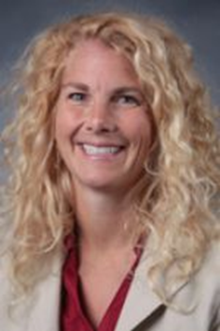
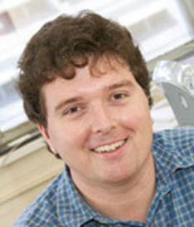
Island 2.0
Customized for teaching biostatistics and clinical trials
Being developed by Susan Telke and team at Minnesota, in collaboration with the Island’s creator, Michael Bulmer
Notes:
Mention some limitations – e.g. runs in real time, very few clinics (so hard to find pts with specific diseases for a clinical trial), etc.

Slide 22
Acknowledgements
Lynn Eberly, Laura Le, Rob Leduc, Greg Grandits, Haitao Chu, Marta Shore, Barbara Kuzmak
Biostatistics and Statistics instructors
Sara Hurley & Jim Harpole
School of Public Health’s Office of E-Learning Services
Michelle Everson & Joan Garfield
Statistics Education program
John Connett, BDAC Director
Brad Carlin, Biostatistics Division Head

Slide 23
References
American Statistical Association (2005, reformatted 2010), Guidelines for Assessment and Instruction in Statistics Education (GAISE) College Report. http://www.amstat.org/education/gaise/index.cfm
Bulmer, Michael and Haladyn, J. Kimberly (2011). “Life on an Island: a Simulated Population to Support Student Projects in Statistics.” Technology Innovations in Statistics Education (TISE) 5(1).
http://escholarship.org/uc/item/2q0740hv
Schulz KF, Altman DG, Moher D, for the CONSORT Group (2010). “CONSORT 2010 Statement: Updated Guidelines for Reporting Parallel Group Randomised Trials.” PLoS Med 7(3): e1000251. doi:10.1371/journal.pmed.1000251.
http://www.plosmedicine.org/article/info%3Adoi%2F10.1371%2Fjournal.pmed.1000251

Slide 24

Questions?
brea0022@umn.edu

